Slide 1

Improving Customer Retention Through Predictive Machine Learning
By: Israel Alcocer, Samuel A. Escobar, Jose Gabriel Lopez-Reyes, Kyle Mitchell, Angel Rosales
Notes:
Kyle

Slide 2
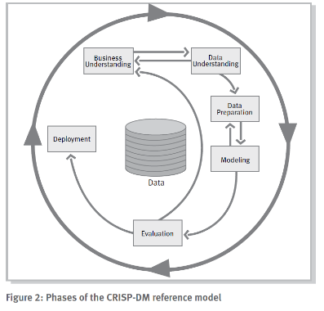
Presentation
Overview
Business understanding
Data understanding
Data preparation
Data modeling
Evaluation
Experiences and future work
Notes:
Kyle

Slide 3
Project Background and Objective
Our group project’s main goal was to predict which customers are likely to churn before the company loses them, allowing the company to use retention strategies such as special offers, improved support, or plan changes to keep them.
Telecom customers use phone, internet, streaming, billing, and support services.
Churn creates recurring revenue loss, so early risk detection supports retention.
Notes:
Angel

Slide 4
Progress Timeline
Week # | Progress Made
Week 1 | - Defined business objectives and machine learning goals. - Identified project requirements, risks, and constraints.
Week 2 | - Inspected the dataset thoroughly and produced a Data Analysis Report - Identified missing values, outliers, and class imbalance
Week 3 | - Began preprocessing, handling missing values, converting categorical and numerical features, normalizing numerical features and other feature engineering steps
Week 4 | - Split dataset into training and test set and implemented machine learning models to be used - Addressed class imbalance by using SMOTE on training sets supplied to models
Week 5 | - Trained models using cleaned and balanced datasets, then tested models - Recorded performance using multiple evaluation metrics
Week 6 | - Compared the models performance - Chose the model with the best performance to be deployed
Week 7 | - Wrote Final Report on the project and it’s progress - Created slides depicting the final version of the project and how it performed
Notes:
Angel

Slide 5
Technologies and Dataset Used
The group has worked on this over the past few months attempting to predict the users who were most likely to drop the service. We gathered our dataset from the kaggle repository labeled Telco Customer Churn. It contains 7032 samples and 21 features. The dataset is reasonable enough to be accomplished on a personal device, but we used Google Colab for everyone in the group to edit and modify the content.
Notes:
Angel

Slide 6
About the Dataset Used
The features contain information about the user such as gender, age, family, information about the service they have been given, and the financial cost they paid. The dataset was released 8 years ago and hasn’t received any update since then, so there could be issues with the dataset regarding the times and users habits. Since the information hasn’t received any update in some time, we had to clean the data to ensure that the model predictions were as accurate as can be.
Notes:
Angel

Slide 7
System Structure
Read Me
This section gives a brief description of the project, instructions to set up the project to run on a personal computer, and lists the environment requirements as well as the expected outputs of the project.
05
Splitting Data and Testing the Model
This section splits the dataset for training and testing of the models. It also applies SMOTE to the training data to account for class imbalance. Finally, it tests and evaluates the model with test data.
01
04
Feature Selection
This section drops features that have no effect on predictions or features that are highly correlated with other features.
Data Loading
The section responsible for importing the necessary libraries that the project uses like Pandas, Sklearn, Matplotlib, etc. It also uploads the dataset to the file from the user’s google drive.
02
03
Data Cleaning and Transformation
This section reformats and transforms data based on it’s type to make it more palatable for the models we will use. It also drops empty values and normalizes numerical features.
Notes:
Kyle

Slide 8
System Structure Diagram
Data
Preprocessing
Modeling
Data Loading
Model Training
- LR, DT, and RF Models trained on testing sets
Telco Customer Churn Dataset
Data Cleaning
- Empty values dropped
- Categorical features encoded
- Numerical features changed to values
Model Evaluation
- Comparison of evaluation metrics to measure performance
Feature Engineering
- Redundant and Dependent features dropped to avoid noise
Train/Test Split
- 80/20 Training and Test Split across 5 folds
Model Selection
- The model with the best performance is deployed
Imbalance Handling (SMOTE)
- SMOTE applied to training sets
Notes:
Kyle

Slide 9
Demo
Notes:
Samuel

Slide 10
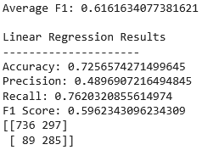
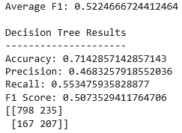
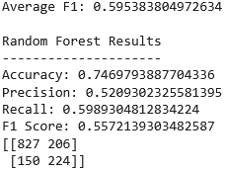
Comparing values
Comparing each model performance
Notes:
Samuel

Slide 11
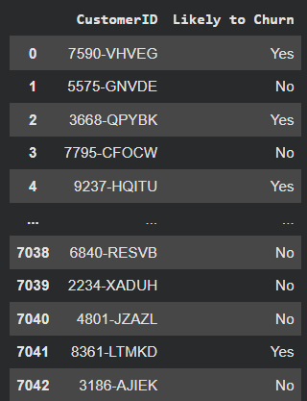
Final Results
Notes:
Samuel

Slide 12
Analysis of Results
The model used was better at finding churn risk customers than avoiding false alerts
Logististics Regression was tested after cleaning, encoding, scaling, and applying SMOTE
Accuracy: 72.6%
Precision: 49.1%
Recall: 76.2%
F1 Score: 59.6%
The model caught many customers who were likely to churn, but it also incorrectly flagged some customers who did not churn. For a retention project, this is still useful because missing a churn customer can be more costly than sending extra retention offers.
Notes:
Israel

Slide 13
Notable Experiences
One Major challenge was preparing the dataset for machine learning
• Many columns used word-based categories like “Yes/No”, contract type, internet service, and payment method.
• The TotalCharges column also had to be converted into numerical form and cleaned before training.
• The dataset was imbalanced because most customers did not churn, so accuracy alone was not enough to judge the model.
• Our group used metrics like recall, precision, F1-score, and a confusion matrix to better understand performance.
We learned that data cleaning and choosing the right evaluation metrics are just as important as training the model.
Notes:
Jose Gabriel

Slide 14
Lessons Learned
When dealing with class imbalance, evaluating models based off raw data is not enough.
F1 score, Recall, etc.
In real world, false positives cost the company money
Giving discount to customer that wasn’t planning on leaving
Importance of data preprocessing
Cleaning and transformation of features in order to be able to work with dataset
Notes:
Jose Gabriel

Slide 15
Future Work
Next steps: improve evaluation, explain results, and turn predictions into action.
Compare models with recall, F1-score, ROC-AUC, and a confusion matrix.
Handle the imbalanced Churn target using SMOTE or class weights.
Use feature importance to explain key churn factors like tenure, contract type, charges, and support services.
Flag high-risk customers for discounts, better support, or plan changes.
Notes:
Jose Gabriel

Slide 16

Any questions?

